Slide 1


Coffee
Sales Data Analysis

Slide 2

Objectives :
The objectives of the coffee sales analysis project are:
Analyze Sales Data – Understand customer purchasing behavior and trends.
Identify Popular Coffee Types – Determine which coffee products generate the most sales.
Track Revenue Trends – Analyze total money spent per coffee type, day, and month.
Optimize Inventory Planning – Use insights to improve stock management.
Forecast Sales – Predict future sales using machine learning models.
Enhance Business Strategy – Provide data-driven recommendations for maximizing revenue.

Slide 3

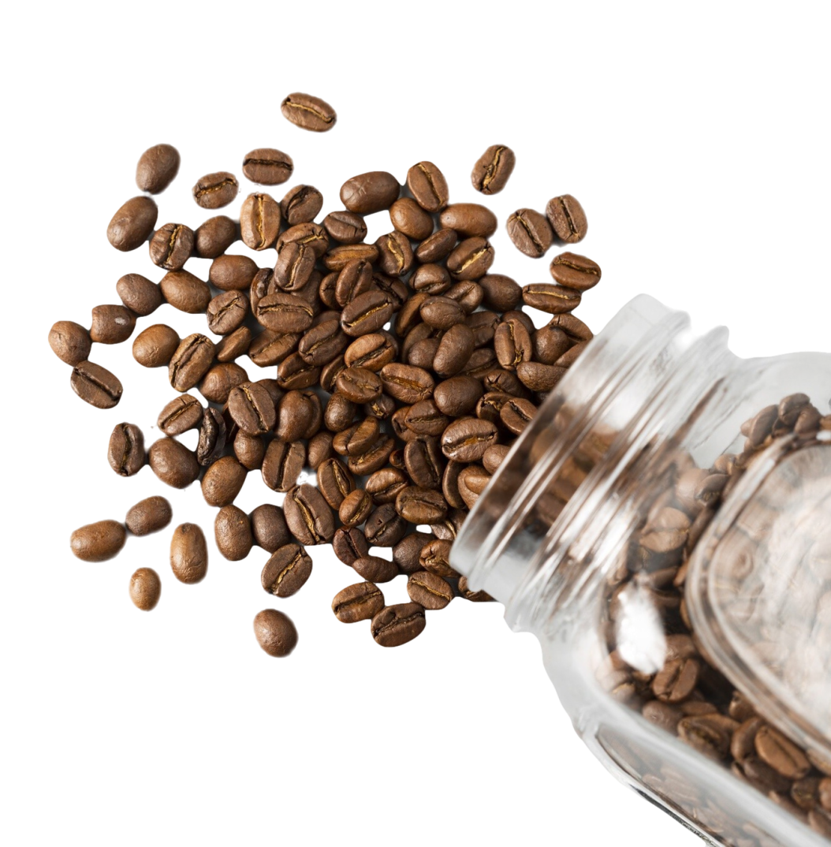
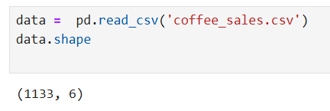
Importing libraries and Modules& Load the dataset :

Slide 4
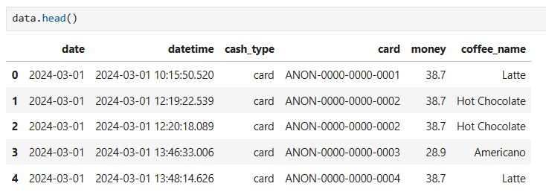
Data Inspection :

Slide 5
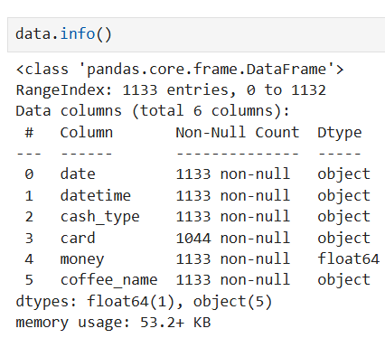
Data Inspection :

Slide 6
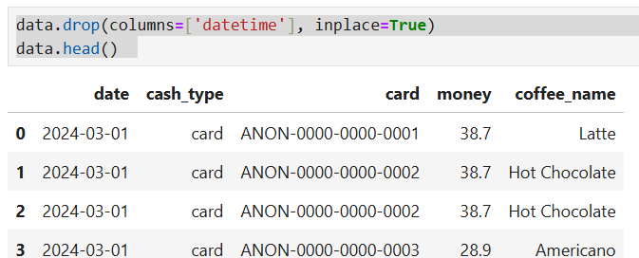
Data Pre-processing :

Slide 7
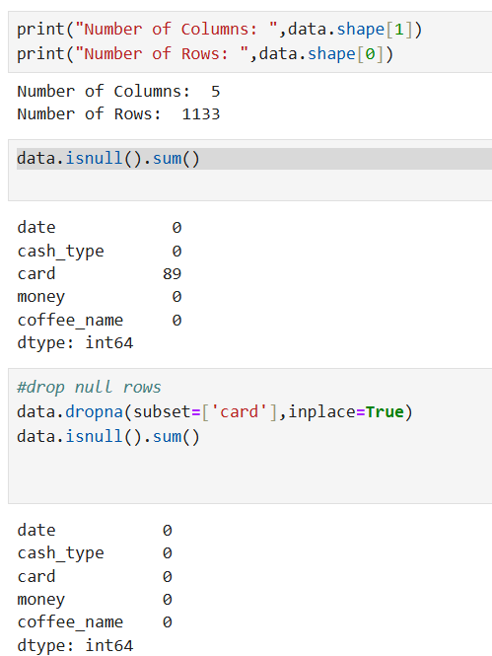
Data Pre-processing

Slide 8
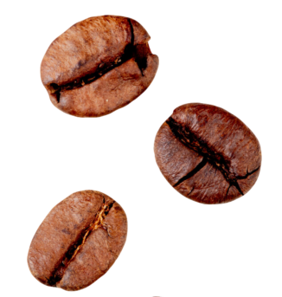
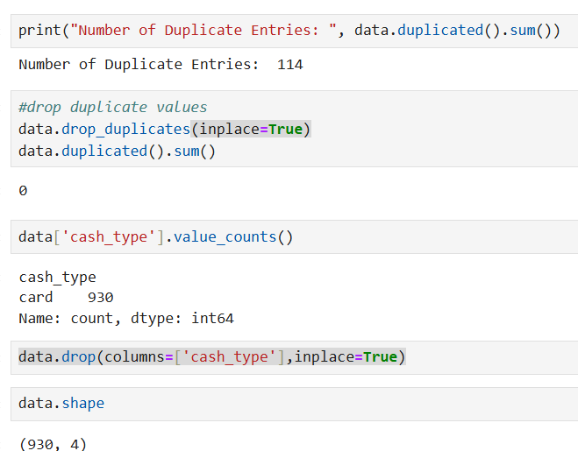
Data Pre-processing :

Slide 9
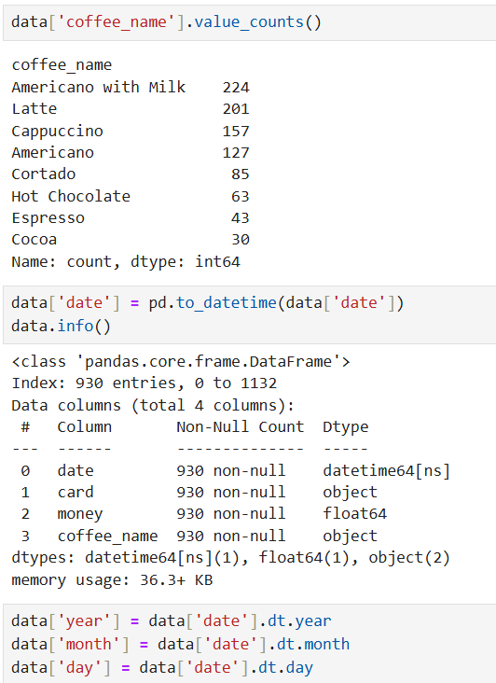
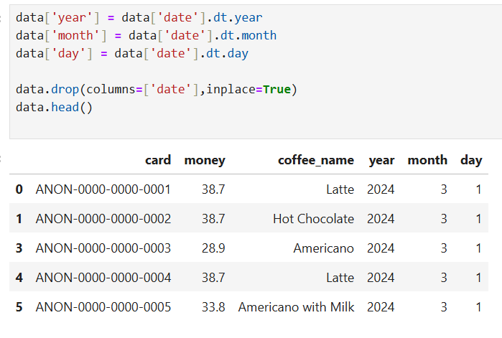
Data Pre-processing :

Slide 10
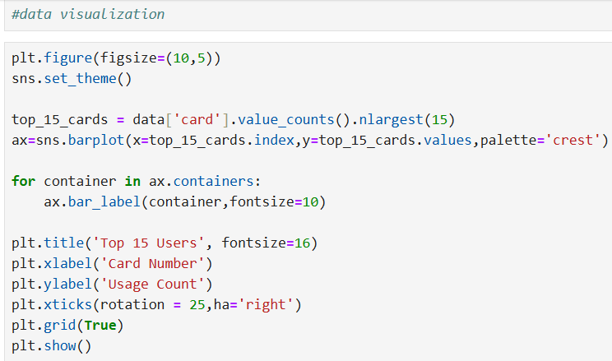
Data Visualization :

Slide 11
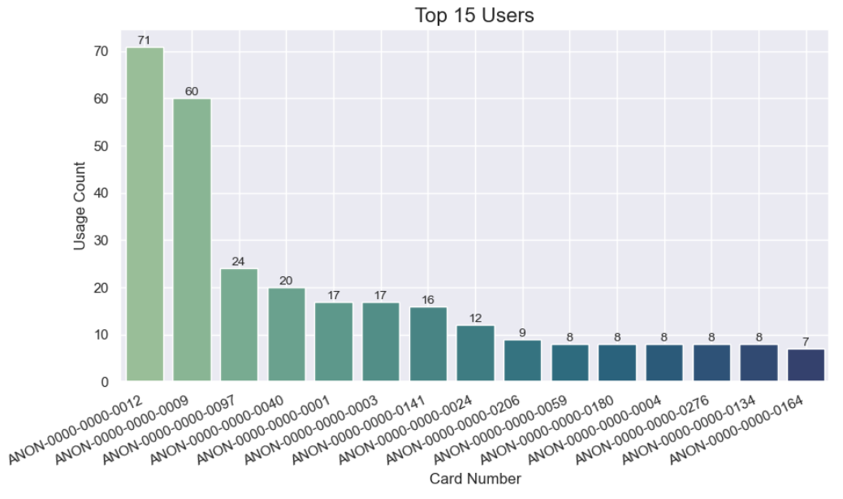

Slide 12

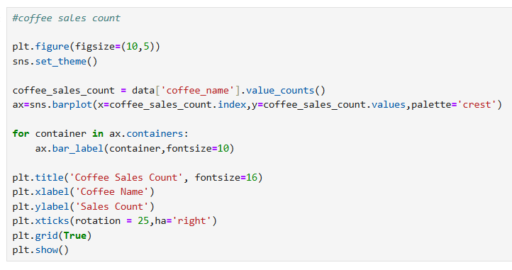
Coffee sales count :

Slide 13

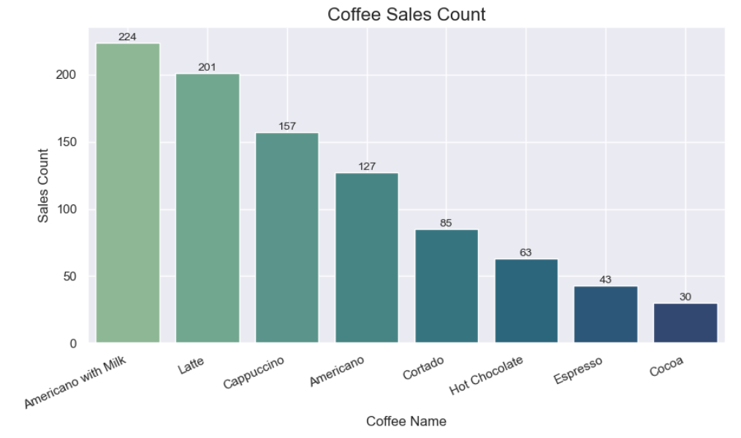

Slide 14
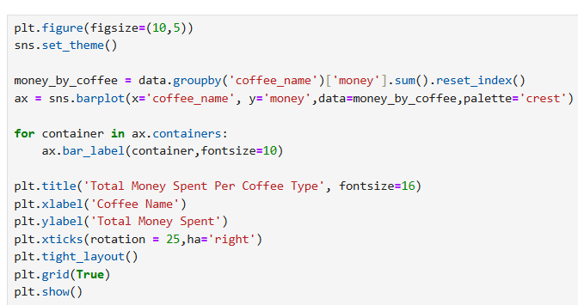
Total Money Spent Per Coffee Type :

Slide 15
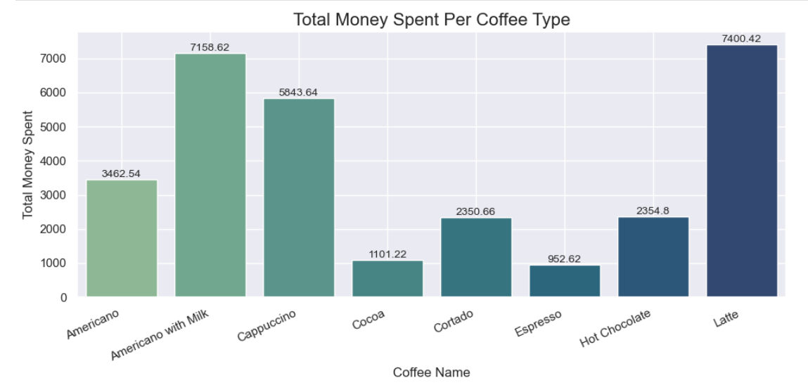

Slide 16
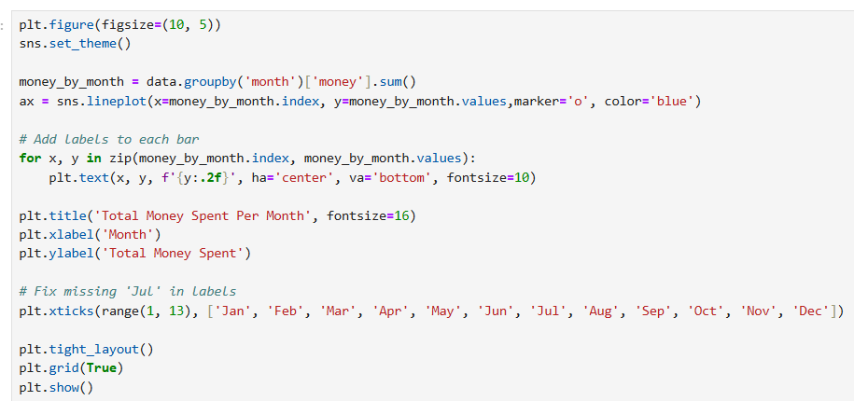
Total Money Spent Per Month :

Slide 17
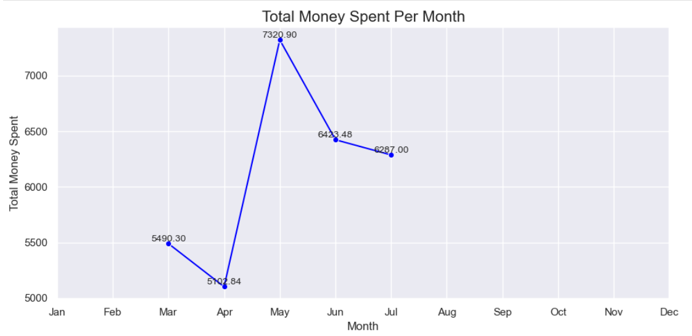

Slide 18
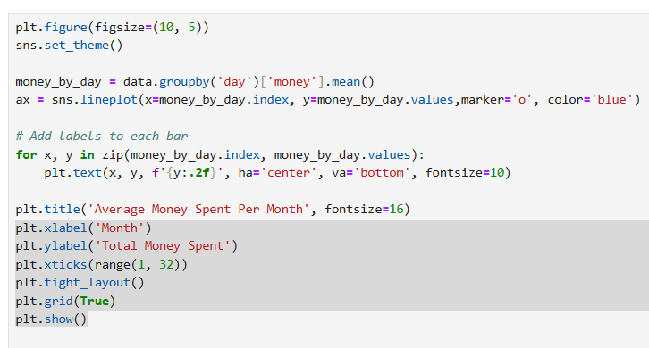
Average Money Spent Per Month :

Slide 19
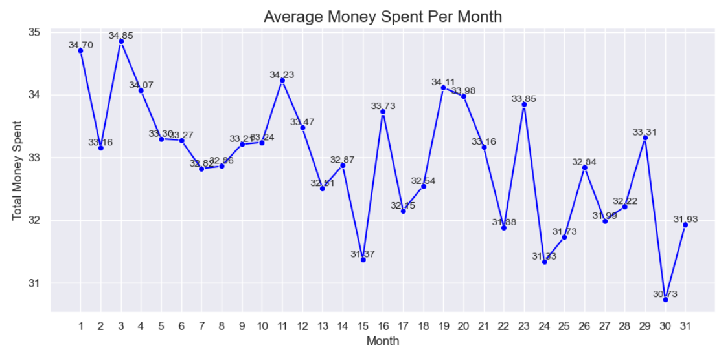

Slide 20
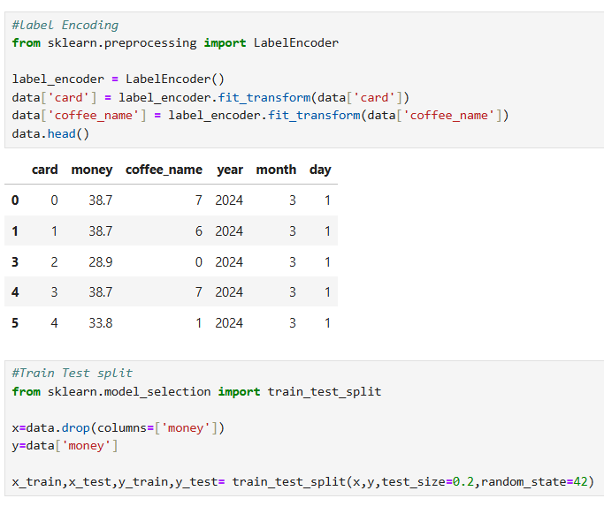
Label Encoding & Train Test Split :

Slide 21
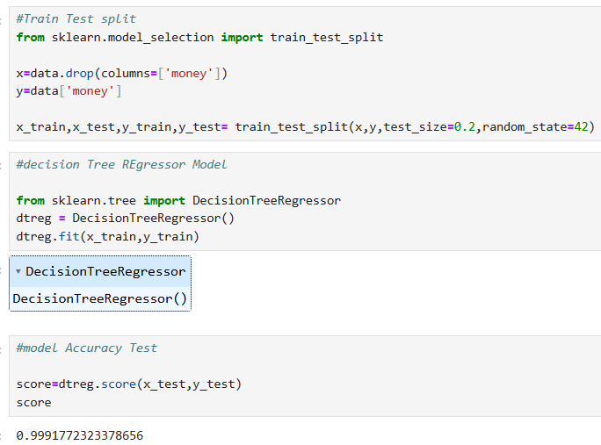
DecisionTreeRegressor Model & Model Accuracy Test :

Slide 22
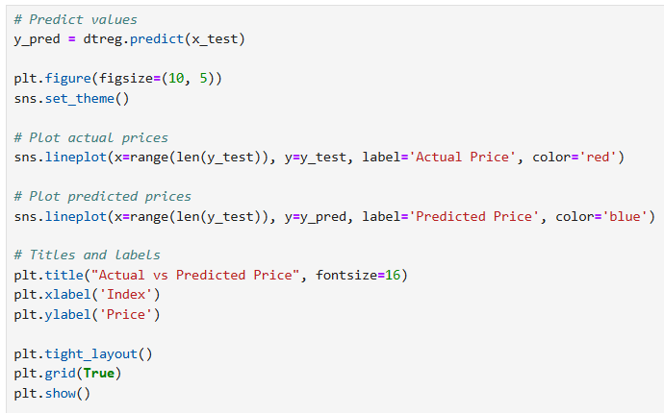
Price Prediction :

Slide 23
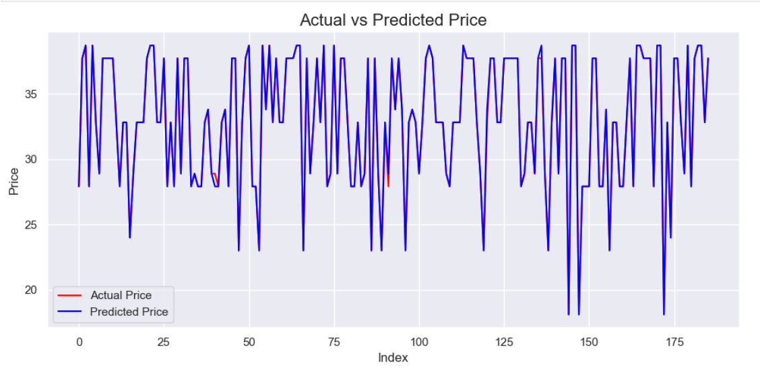

Slide 24
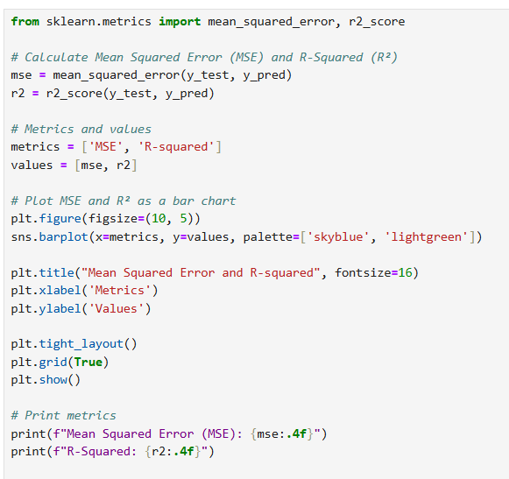
Mean Squared Error & R-Squared :

Slide 25
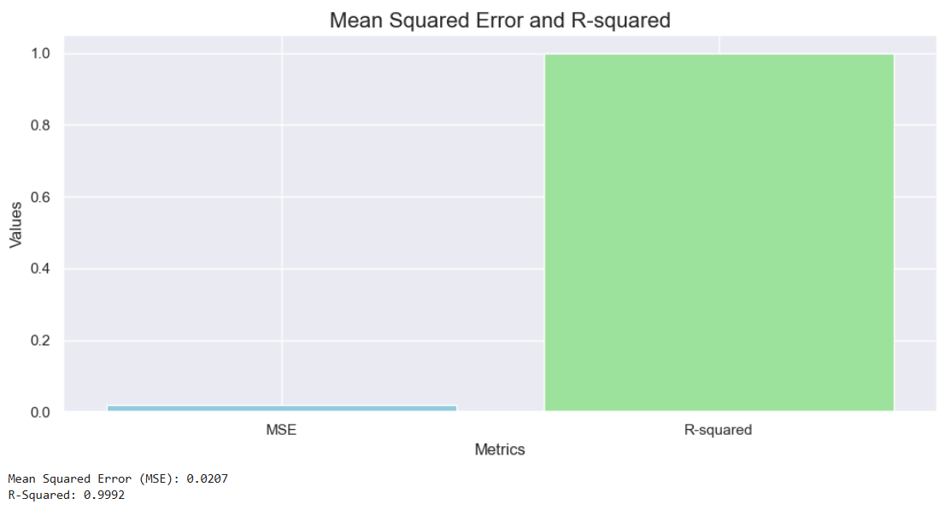

Slide 26
Conclusion Points for Coffee Sales Analysis:
Conclusion Points for Coffee Sales Analysis:
Top-Selling Coffees – Americano with Milk, Latte, and Cappuccino are the most popular choices among customers.
Peak Sales Periods – Sales peak in the morning around 10:00 AM and in the evening around 7:00 PM.
Customer Payment Trends – Majority of the transactions are made using cards, with minimal cash payments.
Revenue Insights – Latte generates the highest revenue, while Espresso has the lowest.
Sales Trends Over Time – Monthly and daily sales patterns help optimize inventory and stocking strategies.
Accurate Sales Prediction – A Decision Tree Regressor model predicts sales with high accuracy (R² = 0.9994).
Business Optimization – Insights can help improve stock management, pricing strategies, and customer experience.

Slide 27

Power BI Dashboard

Slide 28
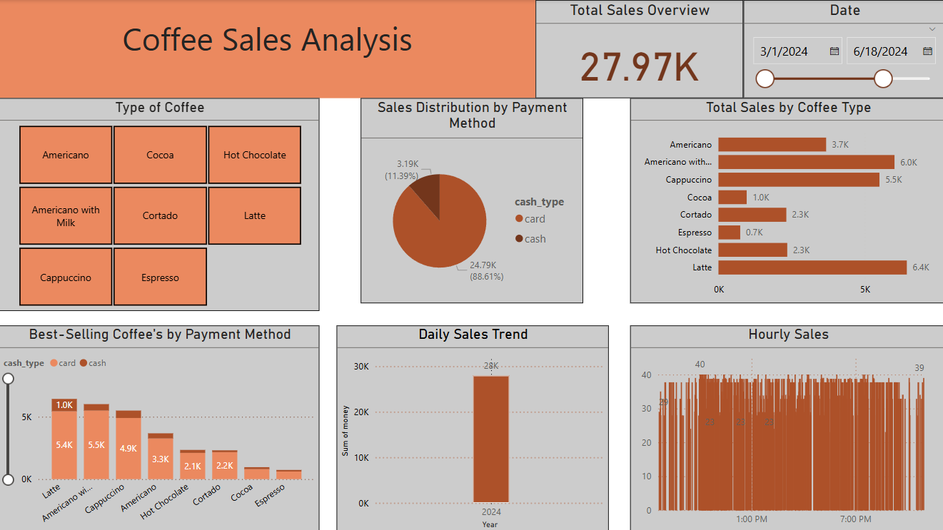

Slide 29
Conclusion Points for Coffee Sales Dashboard :
Top-selling coffees: Latte (6.4K), Americano with Milk (6.0K), and Cappuccino (5.5K).
Payment method: Card (88.61%) is the preferred option over cash (11.39%).
Sales trends: Consistent throughout the day with no major fluctuations.
Total sales: 27.97K, indicating strong business performance.
Low-performing items: Espresso (0.7K) and Cocoa (1.0K) have the least sales.

Slide 30

Thank You

